Slide 1
Romanian deep noun phrase chunking using Graphical Grammar Studio
Radu Simionescu
radu.simionescu@info.uaic.ro
University of Al. I. Cuza Iași, Faculty of Computer Science

Slide 2
Graphical Grammar Studio
A tool for creating and applying a type of Augmented Transitional Networks on text.
ATN - like a state machine but structured into named graphs of nodes. Nodes can “jump” to other graphs.
Similar to Nooj
An open source Java project (on SourceForge https://sourceforge.net/projects/ggs/)
Used for finding and annotating sequences of tokens which meet certain conditions.

Slide 3
GGS Features
Easily edit and test grammars
Find longest maches
Enforce custom priority between grammar paths
Enforce recursion limit for nodes.
(Recursively) Annotate matched tokens
Usable as an end-user tool or as java library.

Slide 4
GGS input format
<S>
<W LEMMA="hol" POS="NOUN" Type="common" Gender="masculine" Number="singular" Definiteness="yes">Holul</W>
<W LEMMA="bloc" POS="NOUN" Type="common" Gender="masculine" Number="singular" Definiteness="yes">blocului</W>
<W LEMMA="mirosi" POS="VERB" Type="main" Mood="indic." Tense="imperfect" Person="third" Number="singular">mirosea</W>
<W LEMMA="a" POS="ADPOSITION" Type="preposition" Formation="simple">a</W>
<W LEMMA="varză" POS="NOUN" Type="common" Gender="feminine" Number="singular" Definiteness="no">varză</W>
<W LEMMA="călit" POS="ADJECTIVE" Type="qualificative" Degree="positive" Gender="feminine" Number="singular" Definiteness="no">călită</W>
<W Type="PERIOD" POS="PERIOD" LEMMA=".">.</W>
</S>
varză călită
preșuri vechi
O zi senină și friguroasă
figura enorma, lată

Slide 5
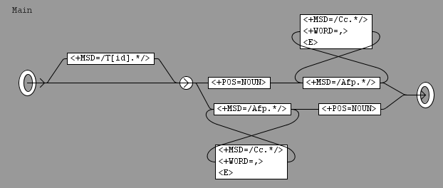
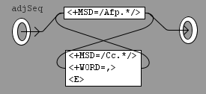
More examples
mici vârtejuri
un singur cuvânt
Jump nodes

Slide 6
A simple recursive Noun Phrase Chunking grammar
O zi senină și friguroasă de aprilie
un turn uriaș și alb deasupra peisajului mohorât
o listă de cifre legate de productia de fontă
figura enorma, lată de_peste un metru
acoperișurile de fier ruginite
Path priority and Annotations

Slide 7
Output
o listă legată de producția de fontă
<NP>
<w MSD="Tifsr" POS="ARTICLE" lemma="un">o</w>
<w MSD="Ncfsrn" POS="NOUN" lemma="listă">listă</w>
<w MSD="Sp" POS="ADPOSITION" lemma="de">de</w>
<NP>
<w MSD="Ncfprn" POS="NOUN" lemma="cifră">cifre</w>
<w MSD="Afpfprn" POS="ADJECTIVE" lemma="legat">legate</w>
<w MSD="Sp" POS="ADPOSITION" lemma="de">de</w>
<NP>
<w MSD="Ncfsry" POS="NOUN" lemma="producţie">producţia</w>
<w MSD="Sp" POS="ADPOSITION" lemma="de">de</w>
<NP>
<w MSD="Ncfsrn" POS="NOUN" lemma="fontă">fontă</w>
</NP>
</NP>
</NP>
</NP>

Slide 8
Output
acoperișurile de fier ruginite
<NP>
<w MSD="Ncfpry" POS="NOUN" lemma="acoperiş" >acoperişurile</w>
<w MSD="Sp" POS="ADPOSITION" ana="#Sp" lemma="de">de</w>
<NP>
<w MSD="Ncmsrn" POS="NOUN" lemma="fier">fier</w>
<w MSD="Afpfprn" POS="ADJECTIVE" lemma="ruginit">ruginite</w>
</NP>
</NP>
The adjective “ruginite” should not be in the same NP as “fier” because they don’t agree in number and gender. The correct structure is:
<NP>
<w MSD="Ncfpry" POS="NOUN" lemma="acoperiş" >acoperişurile</w>
<w MSD="Sp" POS="ADPOSITION" ana="#Sp" lemma="de">de</w>
<NP>
<w MSD="Ncmsrn" POS="NOUN" lemma="fier">fier</w>
</NP>
<w MSD="Afpfprn" POS="ADJECTIVE" lemma="ruginit">ruginite</w>
</NP>

Slide 9
Romanian NP chunker grammar
General aspects
Should take into account the agreement between nouns, adjectives, articles and determiners.
Romanian NP structure is quite flexible, but it does have constraints which must be taken into account. The following expressions should be chunked successfully in the same manner as bellow:
[acoperișurile [de fier] ruginite]
[ușile [de sticlă] ale [blocului Victoria]]
[ușile [de sticlă a [blocului Victoria]]]
[vocea arțăgoasă de_la [tele-ecran]]

Slide 10
NP chunks finding grammar
cea mai frumoasă carte
o foarte talentată actriță
banca aceea grea

Slide 11
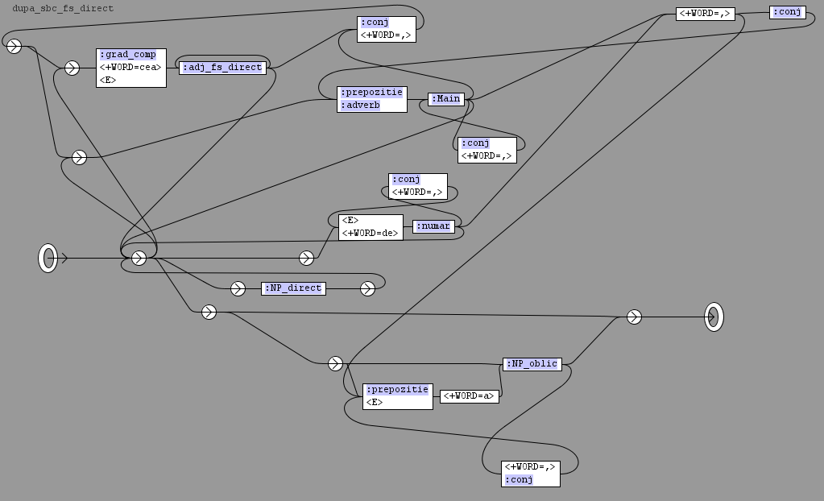
NP chunks finding grammar
[o cafea neagră și [cu miere dulce]]
[o cafea mai tare]
[cafeaua cu [lapte], [miere] și cu [scorțișoară]]
[ușa de [sticlă], a [blocului]] vs
[ușa de [sticlă a [blocului]]]
[cafeaua cu [lapte], [miere] și [scorțișoară]]
[cheia de 15]
[cafeaua [secretarei]]
[o cafea de a [secretarei]]

Slide 12
NP chunking grammar statistics
122 graphs
1288 nodes
212 token matching nodes
466 jump nodes
1621 arcs
28308 NPs in the 1984 corpus (6726 sentences, 118334 tokens)

